Slide 1
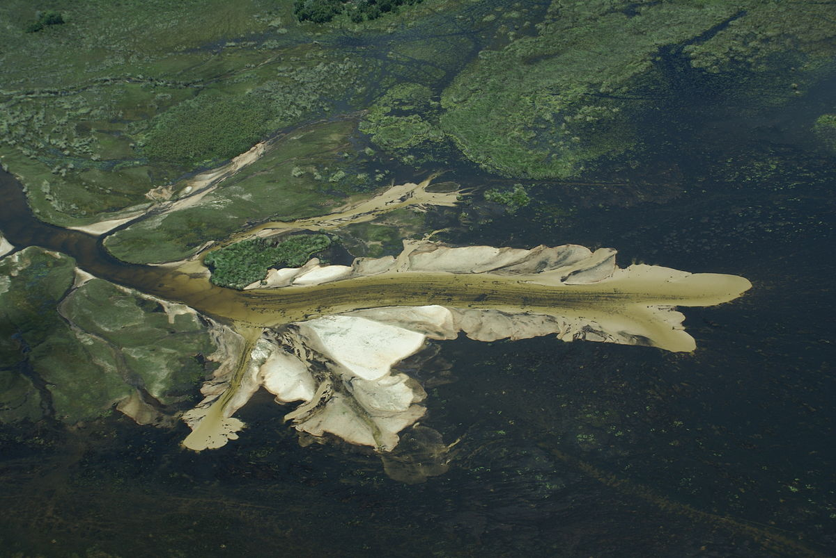
Chapter 10: Deposition
SURFACE PROCESSES

Slide 2
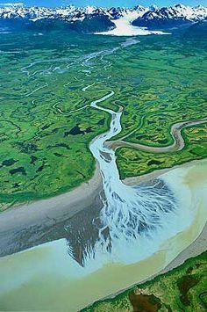
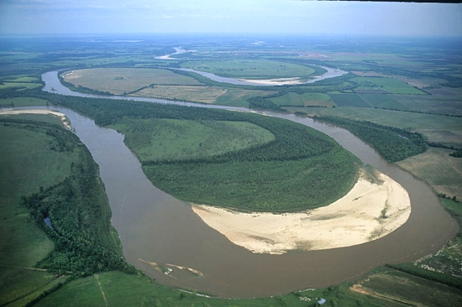
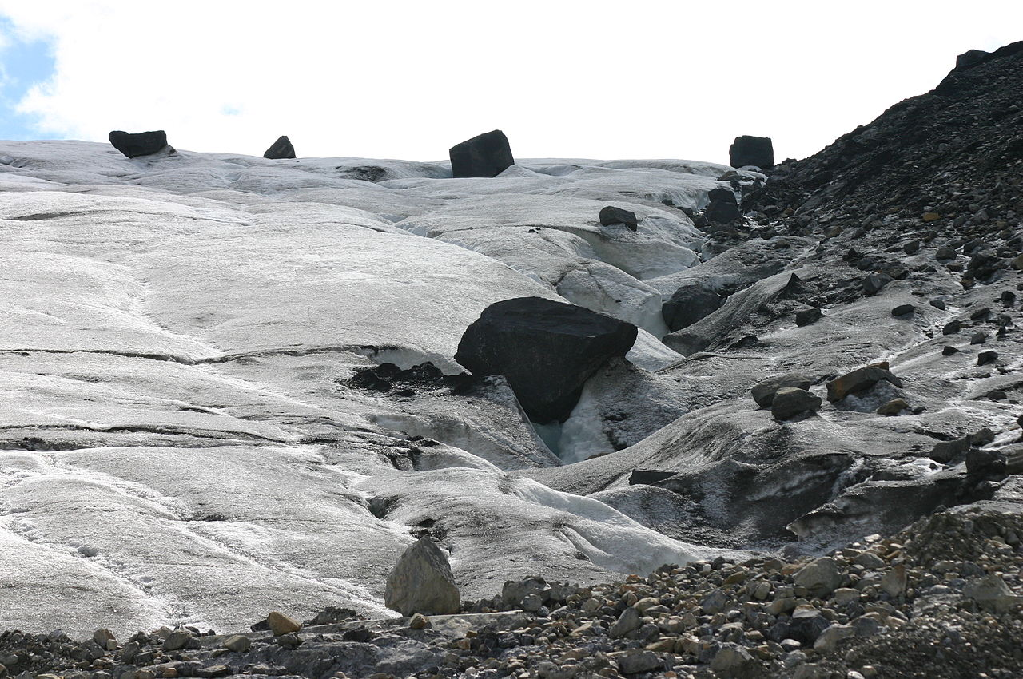

Gravity, Wind, Water, Ice and Wave Action are also responsible for creating depositional features on Earth

Slide 3
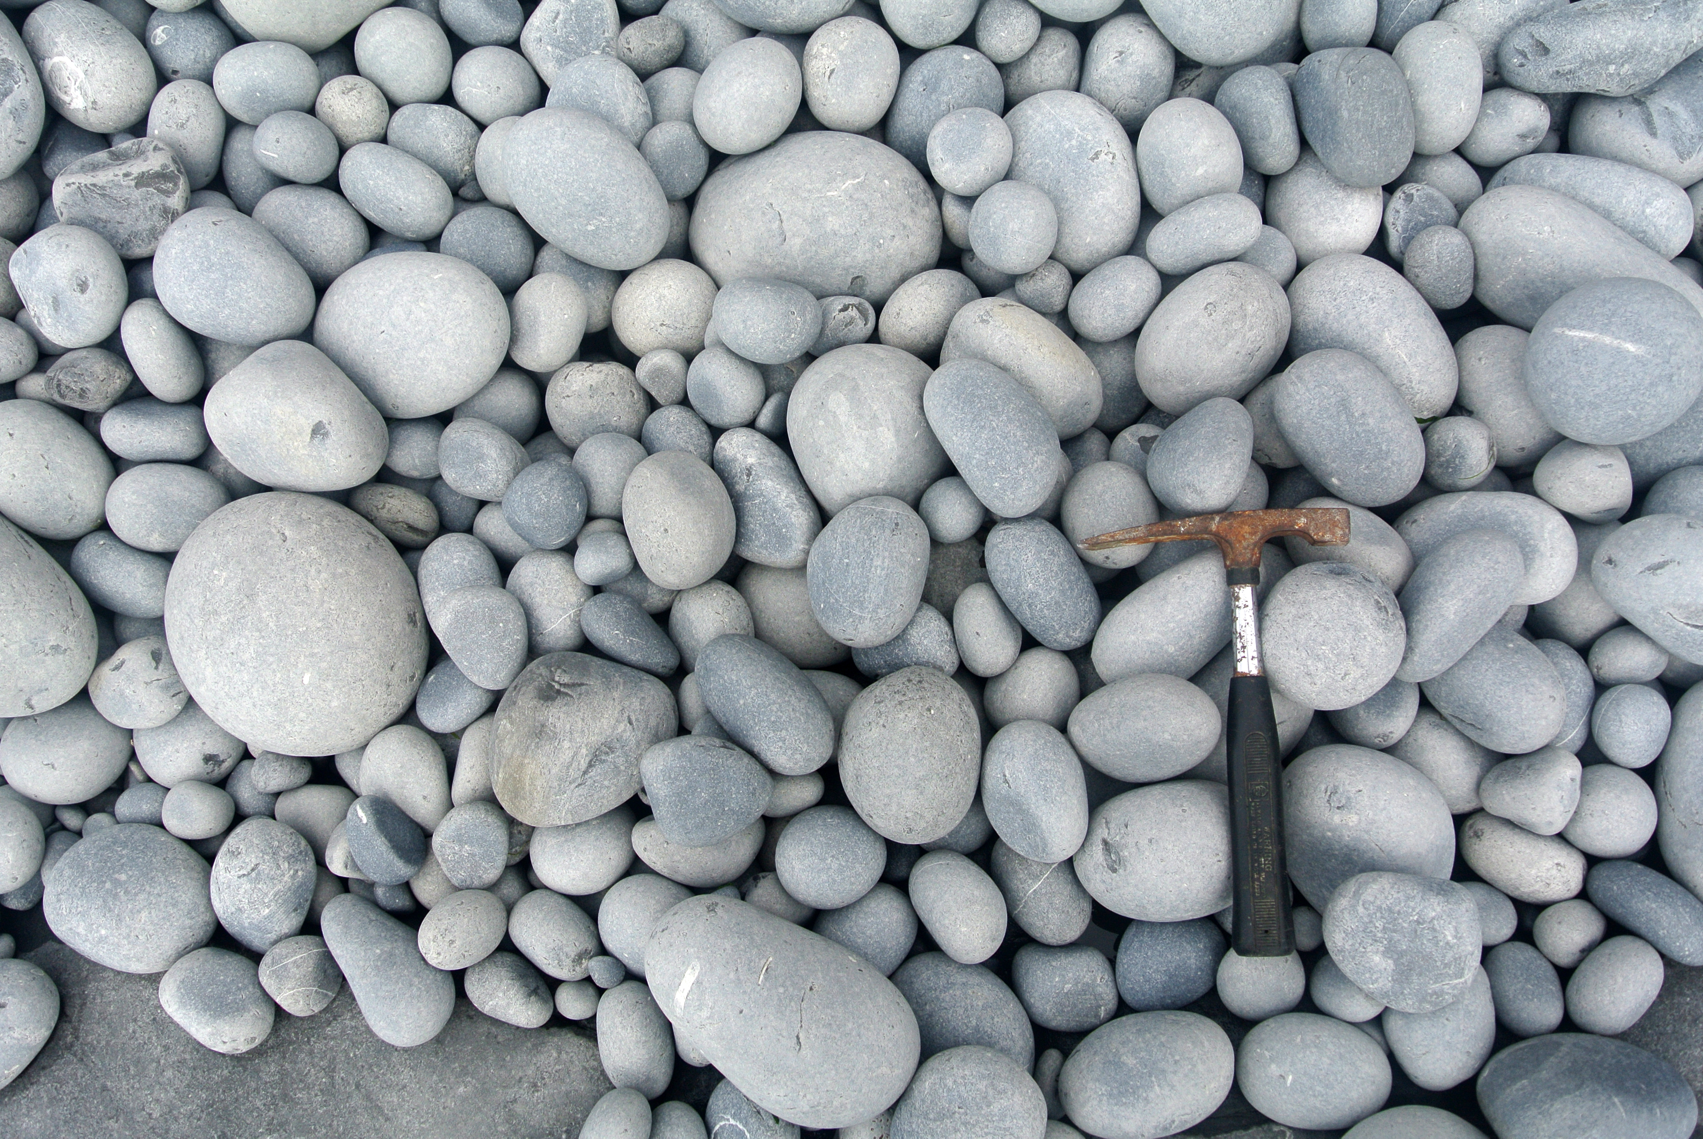
Deposition: Process by which sediments are released, settled from, or dropped from an erosional system
Most final deposition occurs in large bodies of water because running water is the most important natural erosional system, but before sediments reach bodies of water, they are deposited in different environments by
  1. Glaciers
  2. Wind
  3. Waves/ocean currents
  4. Gravity/Mass Movements
  5.Running water

Slide 4
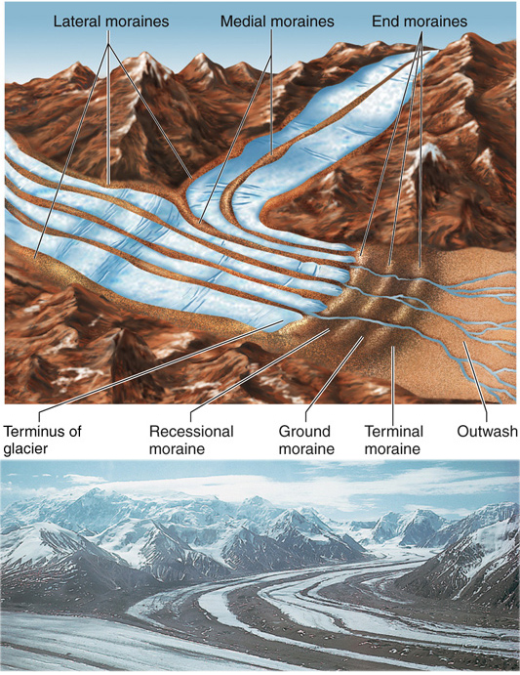
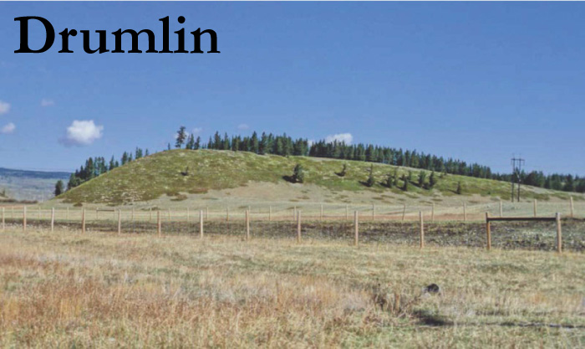
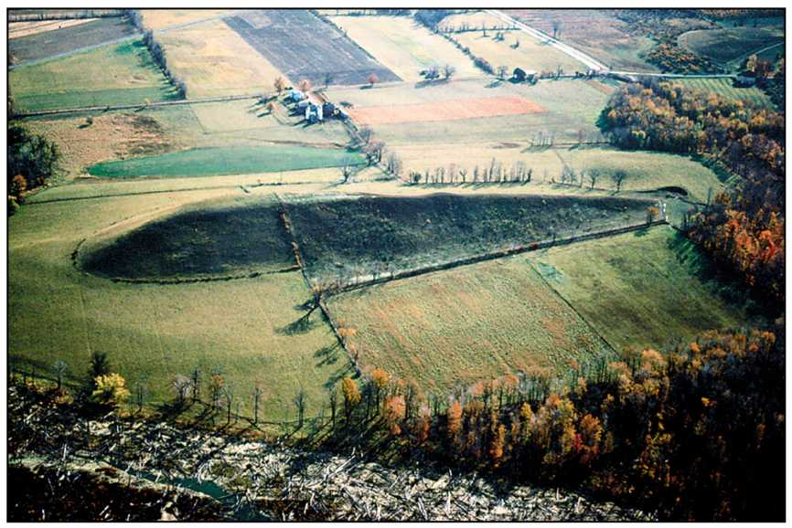
GLACIAL DEPOSITION:MORAINES
Moraines: along the bottom, edges and at the end of a glacier, the sediments it carries are just dropped in unsorted (Mixed) piles of sediment called till.
A Terminal Moraine marks the furthest extent to where the glacier moved during glaciation
A Ground Moraine is formed due to a thin sheet of till accumulating at the bottom of a glacier
If a glacier mounds up the ground moraine into an oval shape as it moves, it creates a drumlin

Slide 5
When a glacier recedes (melts and moves backward)
Glaciers can leave behind ice blocks within the terminal or ground moraine as it melts backward leaving behind either a kettle hole or a kettle lake (if the kettle meets the water table at that area)
Melting Glacial water will carry sediments from the glaciers to produce layered and sorted (not mixed) sediments when the water slows down/stops. This is known as an outwash plain (Much of southern long island)
ESKERS are long winding ridge of sediments that are sorted and layered because they are deposited by running water from melt beneath the glacier
Glacial Erratics- are boulder sized rocks that were eroded during advance and then deposited by a glacier during retreat

Slide 6
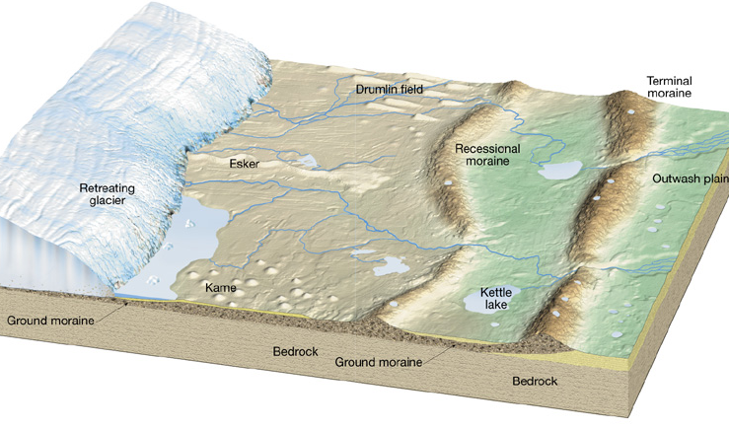
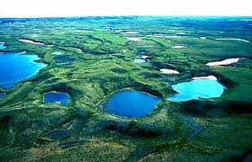
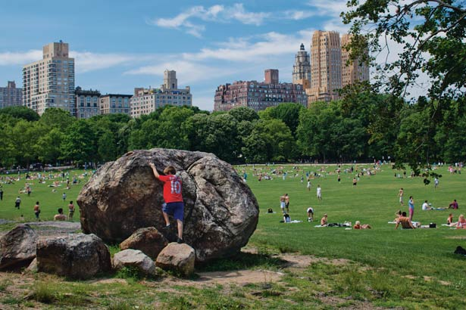
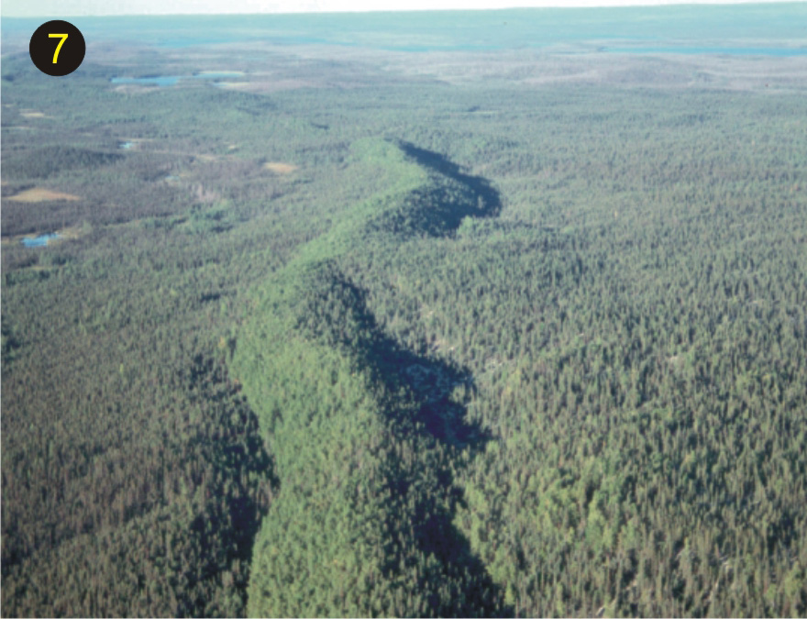
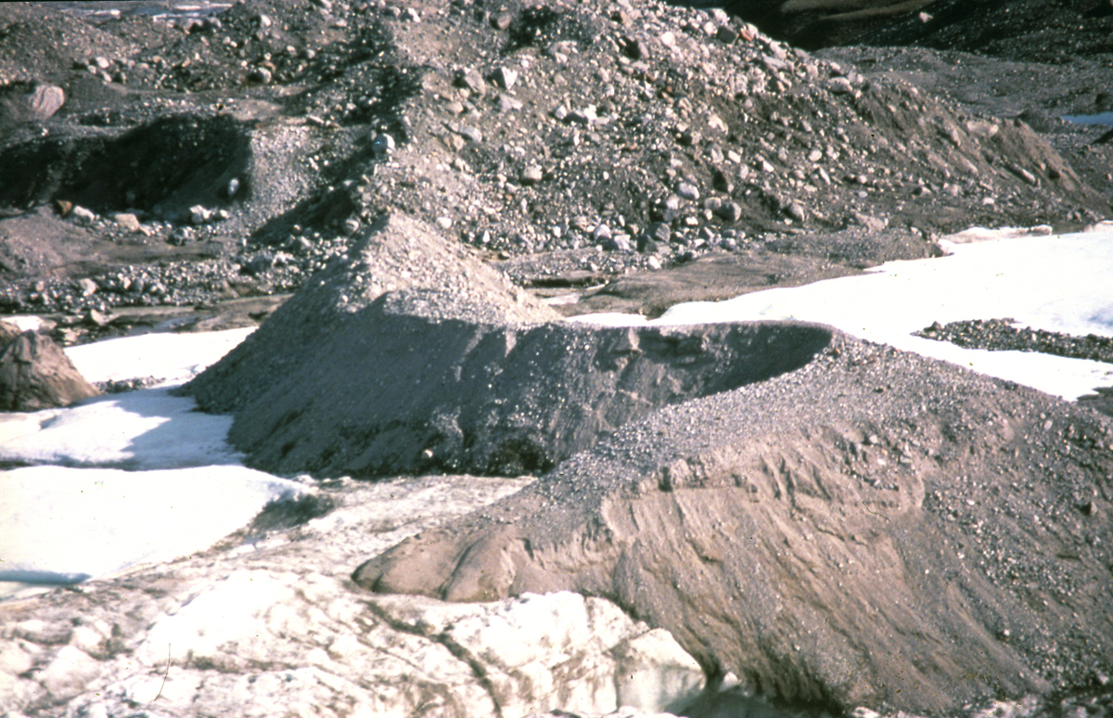

Slide 7
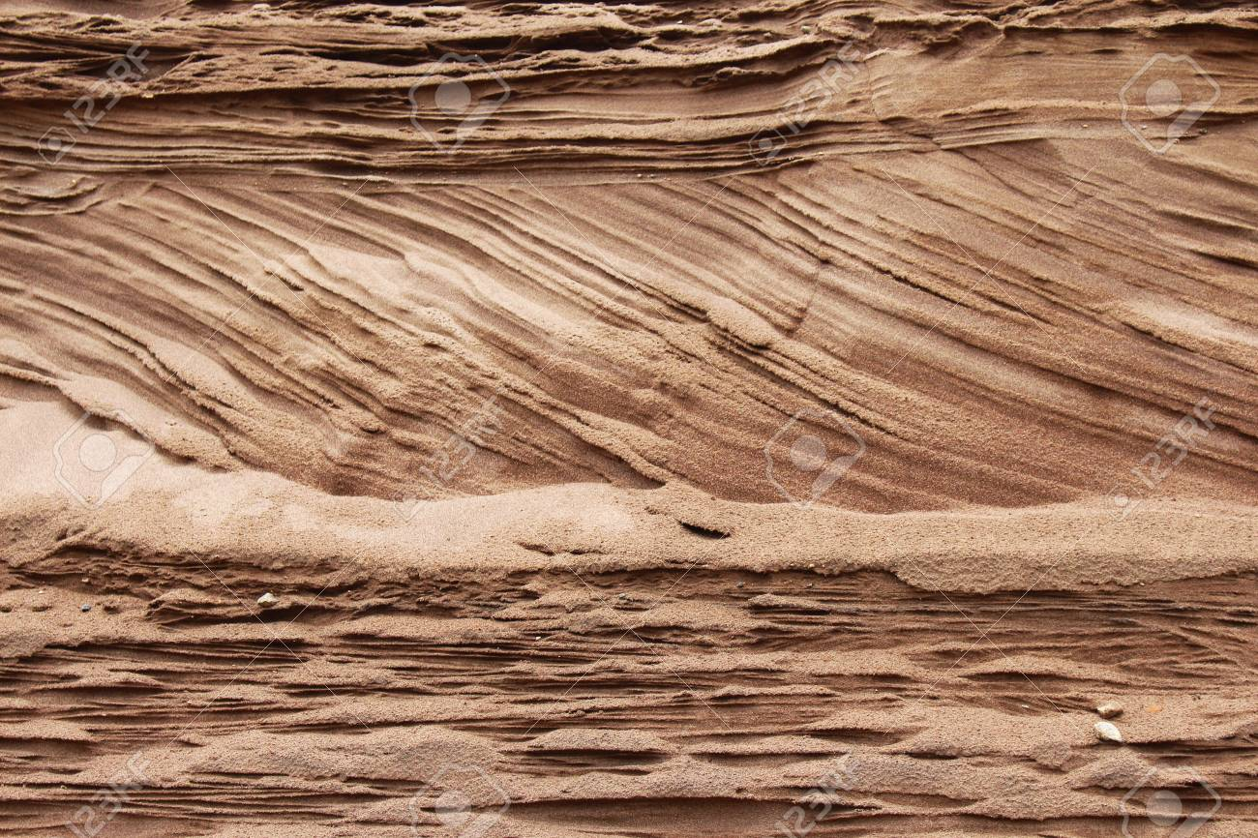
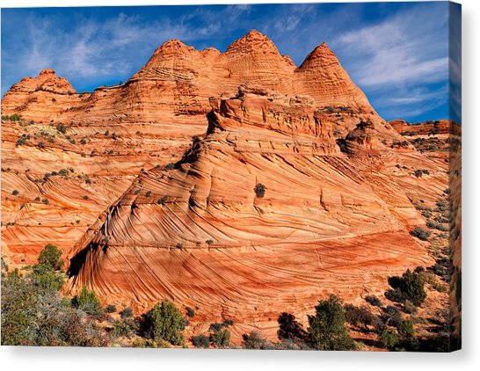
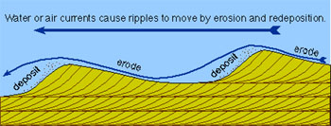
Deposition by wind
Wind generally deposits finer sediments such a dust, ash, silt and sand over large spaces of land
Crossbedding can occur when sand dunes migrate according to a change in wind direction

Slide 8
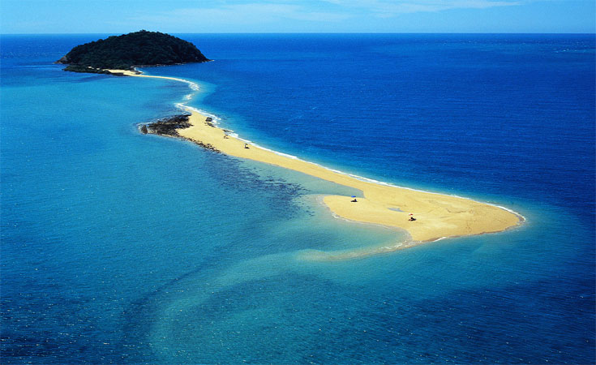
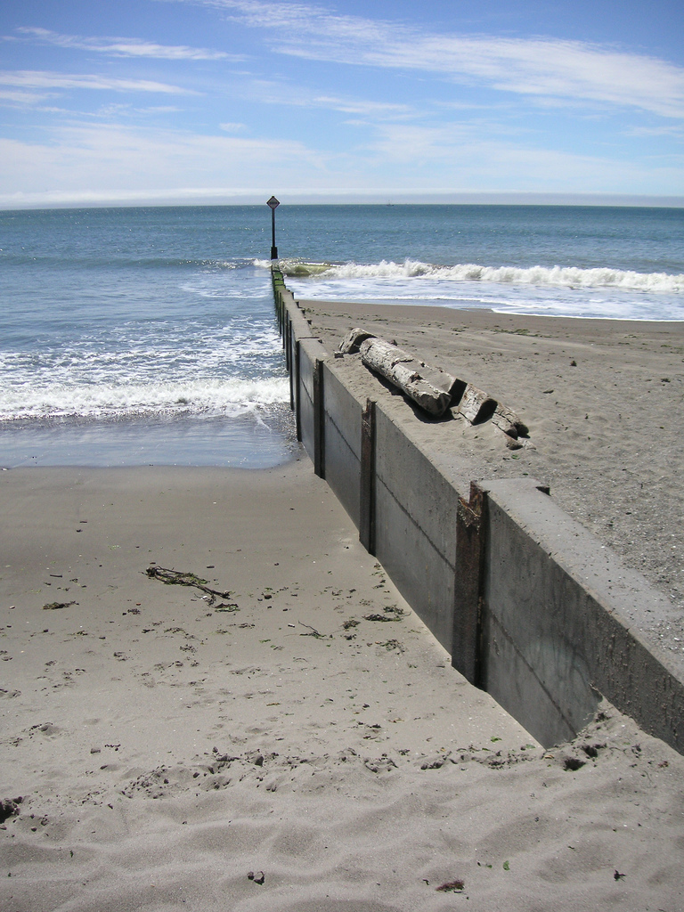
Deposition on Coastlines by Ocean Currents/Wave Action
Beaches- are created when an ocean/lake wave slows down as it drags across the approaching shoreline and deposits a strip of sediment.
Deposition will always occur on the side of a jetty/groin facing the longshore current
Sandbars are created when longshore current transports sediment in the direction of longshore drift
A barrier island is created when the sediment on a sandbar piles up enough to grow vegetation and stabilize the sediment.

Slide 9
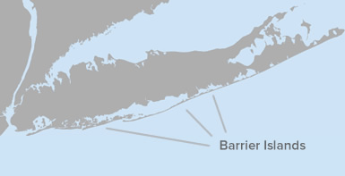
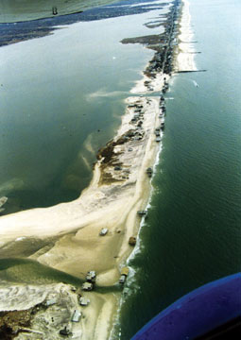

Slide 10
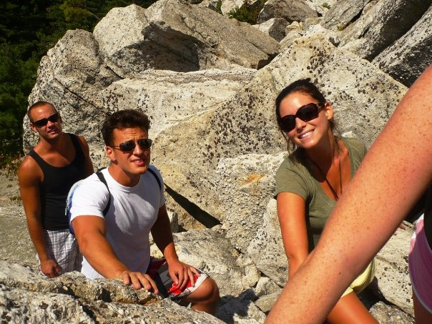
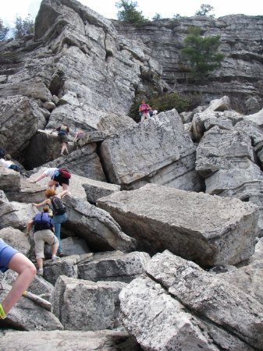
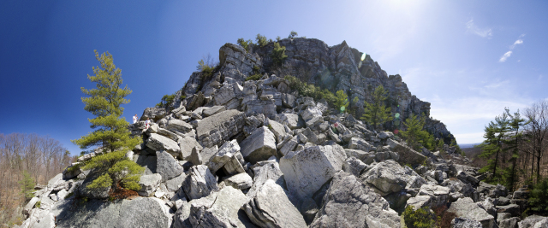
DEPOSITION BY Mass Movement
Deposition by a Mass Movement always results in unsorted sediments, usually quite large, being deposited at the bottom of the slope/cliff. These sediments will be angular (sharp edges)

Slide 11
Deposition by running water
How fast sediment is deposited in this system is determined by:
  1. The velocity of the system
    Faster velocity= more erosion
    Slower Velocity= More deposition
    Refer to pg. 6 of ESRT ! If a stream flows below a given velocity, it will deposit the sediments it can no longer carry.
  2. The characteristics of the sediments themselves
    Size- Larger particles settle out Faster
    Shape- Rounder particles settle out faster, and flatter slower
    Density – higher density particles settle out faster

Slide 12
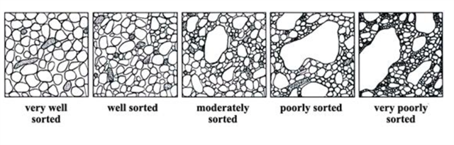
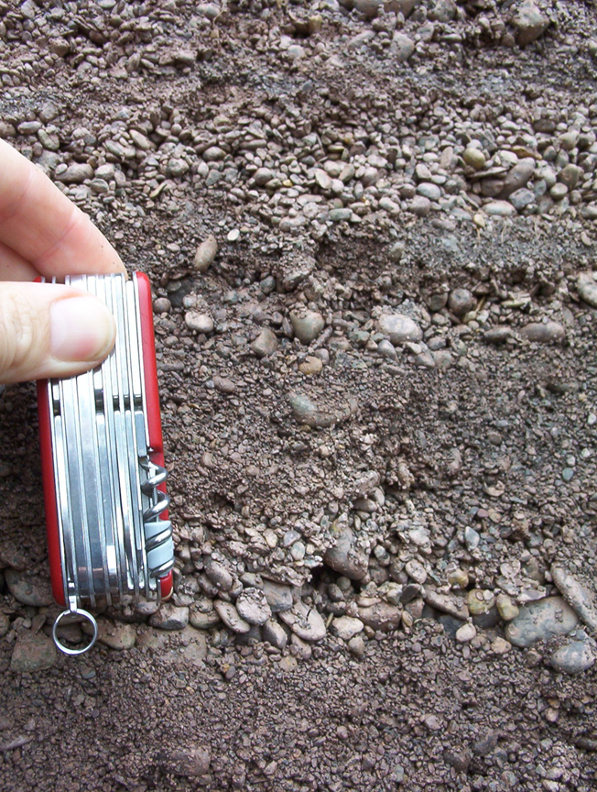
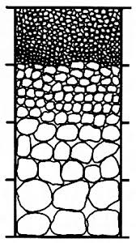
The sorting of Sediments Fluvial Deposition:
If a deposit or layer of sediment has particles that are similar in size, density, or shape, they are considered SORTED
When a mixture of sediments in water settle out rapidly, a horizontal bed (layer) develops with sedimentary size decreasing from bottom to the top, creating graded bedding.

Slide 13
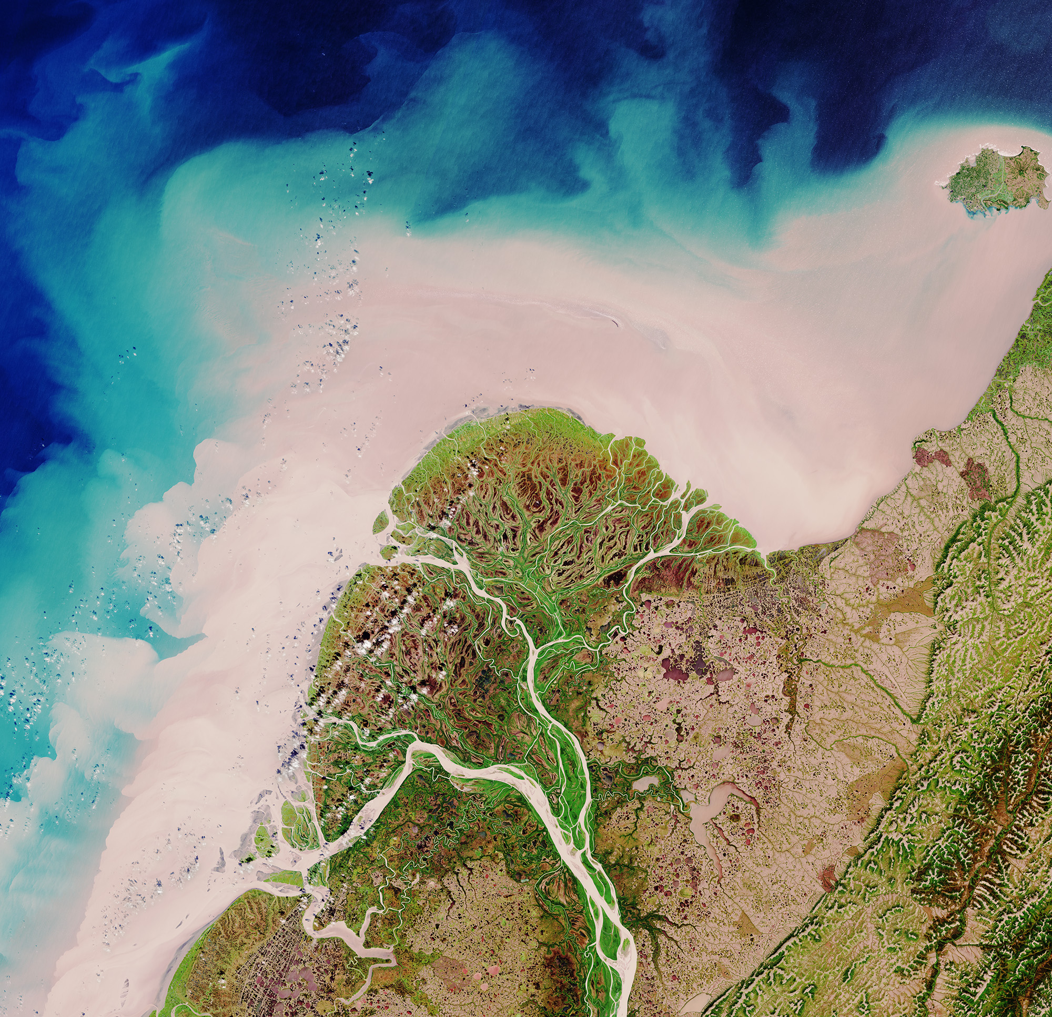
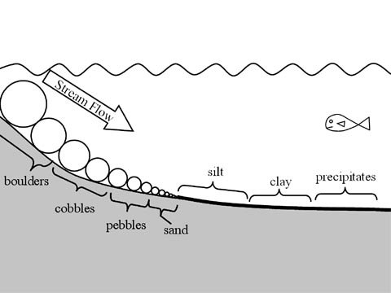
Formation of a delta
When a river enters a larger body of water (lake or ocean), deposition will occur as the stream velocity naturally decreases due to a decrease in slope, and the collision of two flowing bodies of water. Horizontal sorting will occur, where larger, denser, and rounder sediments settle out first, while finer, flatter particles settle out last.

Slide 14
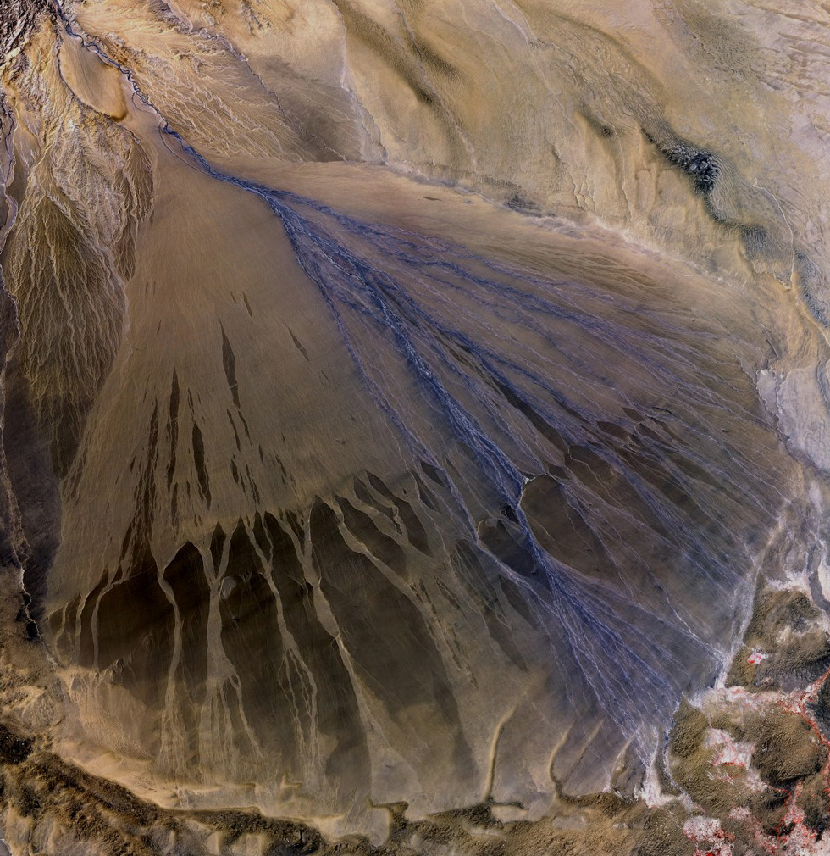
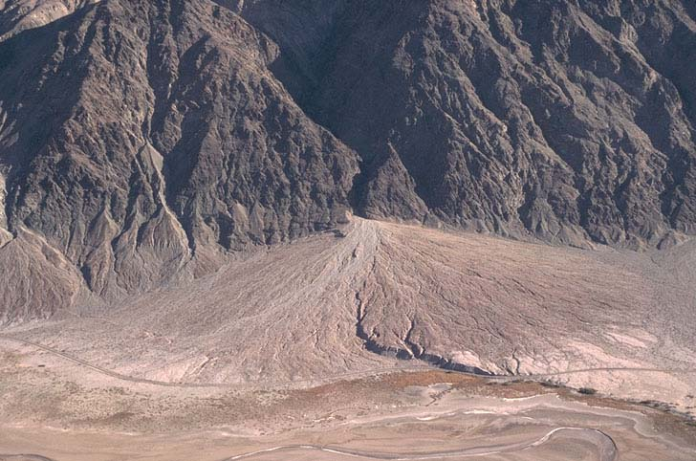
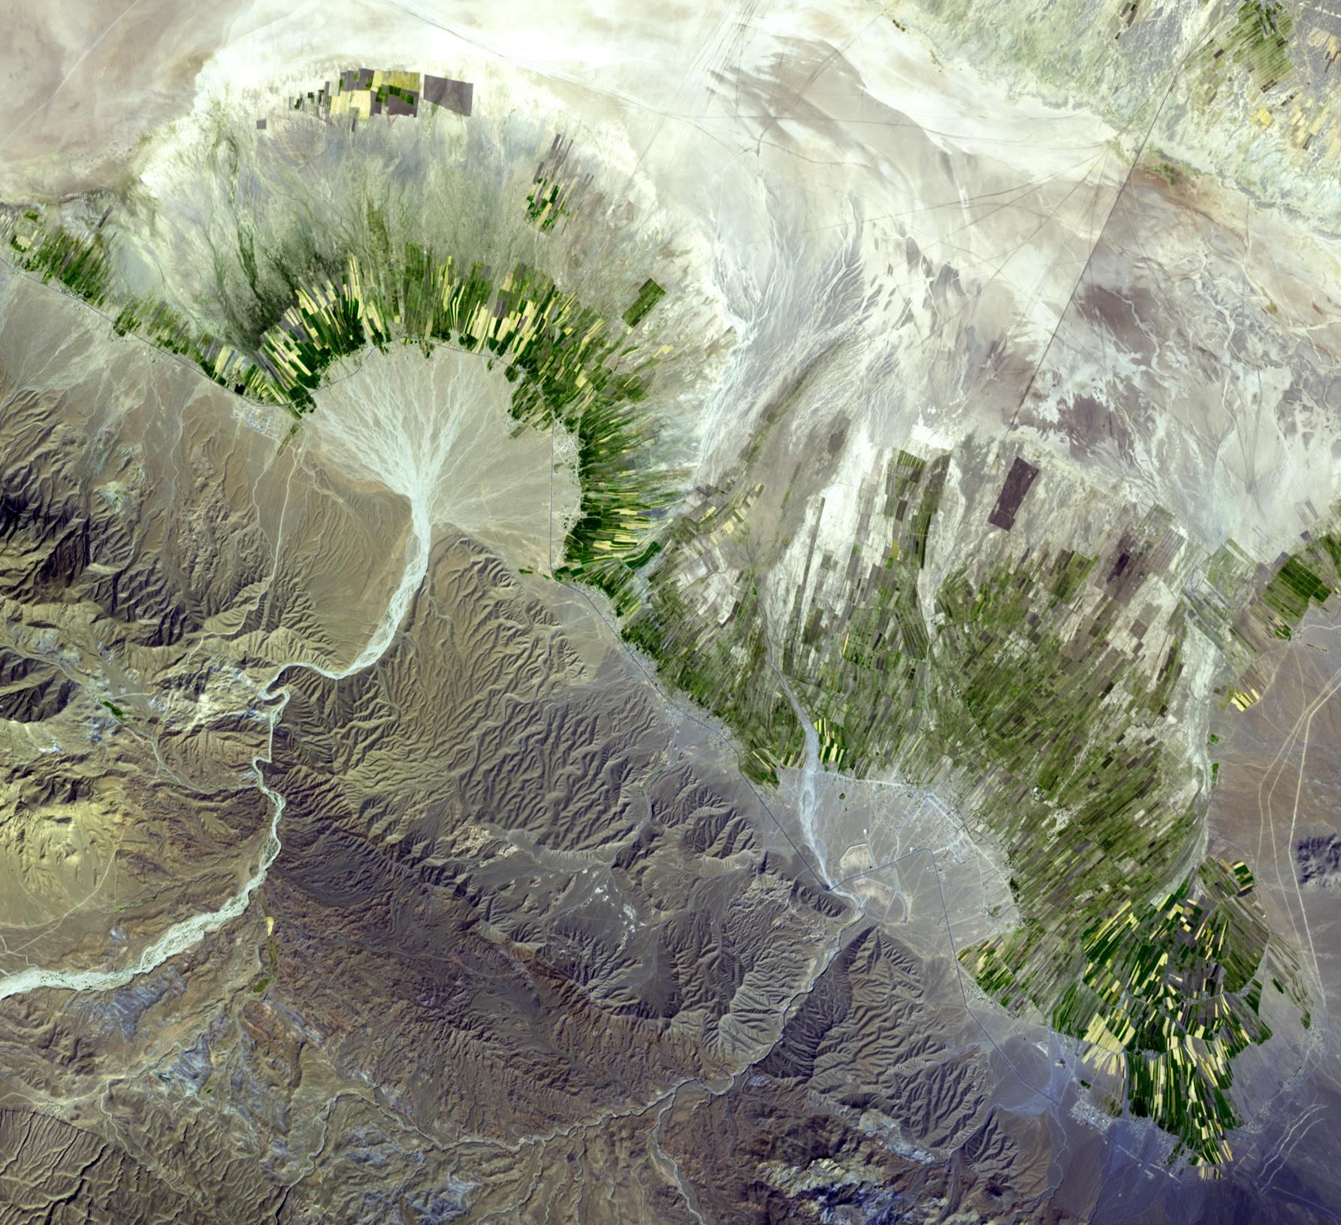
Formation of an Alluvial Fan
Is formed by running water in smaller rivers and streams at High altitudes. They carry sediment by erosion and deposit sediment over the ground as the stream fans out over a gentler slope, creating a Cone shaped area of sediment.

